Slide 1

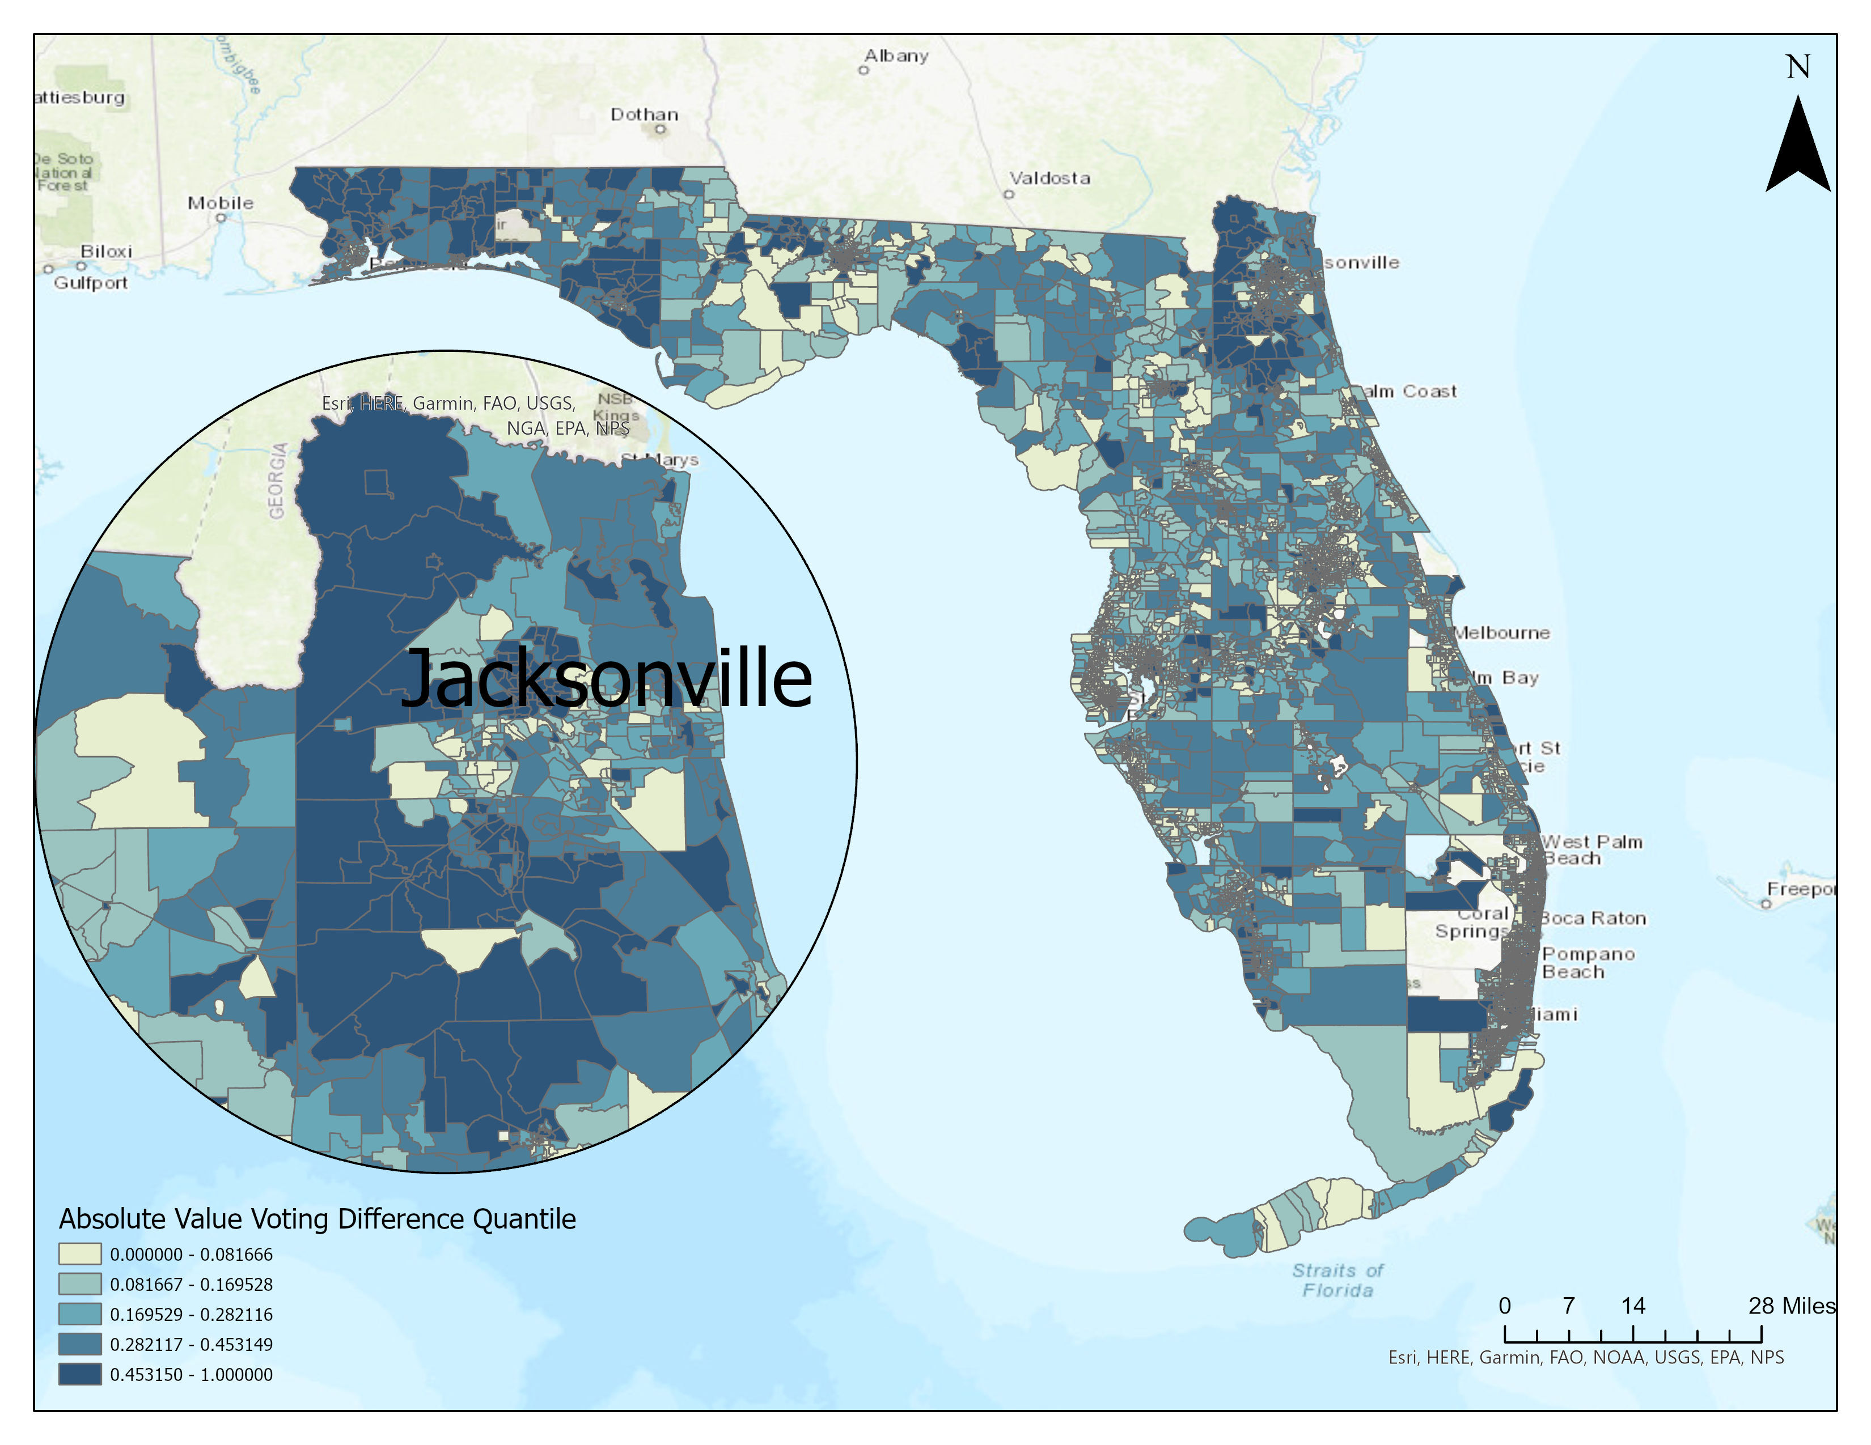
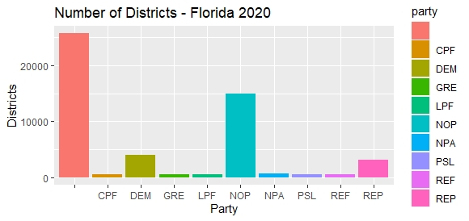


Sesame Street Neighbor’s Tasks
1 2 3
Visualization 2

